Slide 1
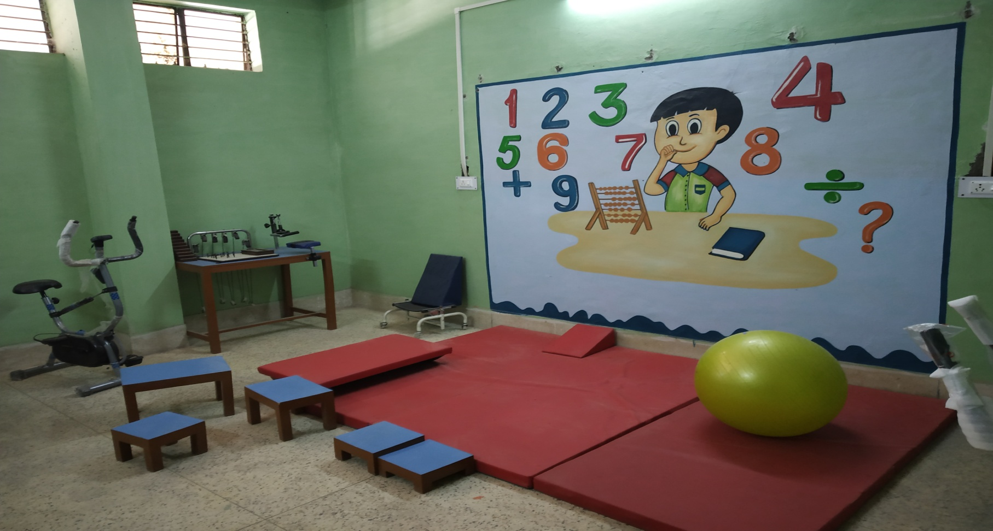
Regional Early Intervention Centre

Slide 2
REIC(Regional early intervention centre) was started in 2016 with the support of NHM.
Every week almost 100 patients of neurology and development disorder comes for their treatment.
It run sessions of Audiology, Physiotherapy, Psychology, NFC, Graduatuon in it.
It's a training centre of DEIC Employee of whole state.

Slide 3
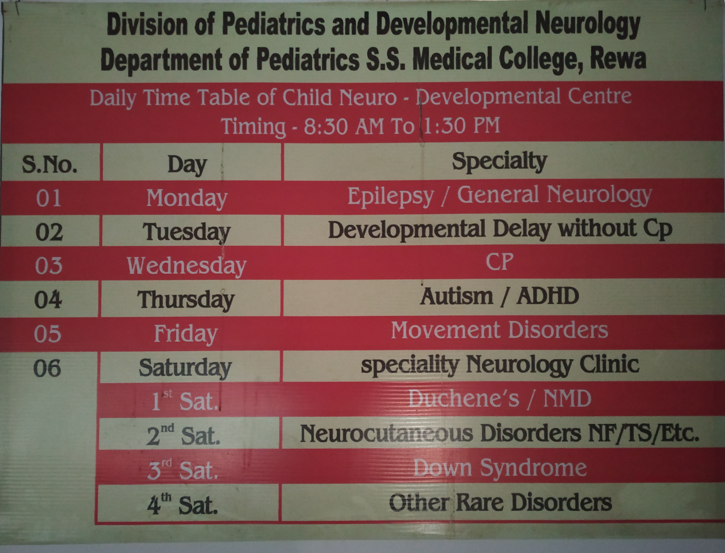

Slide 4
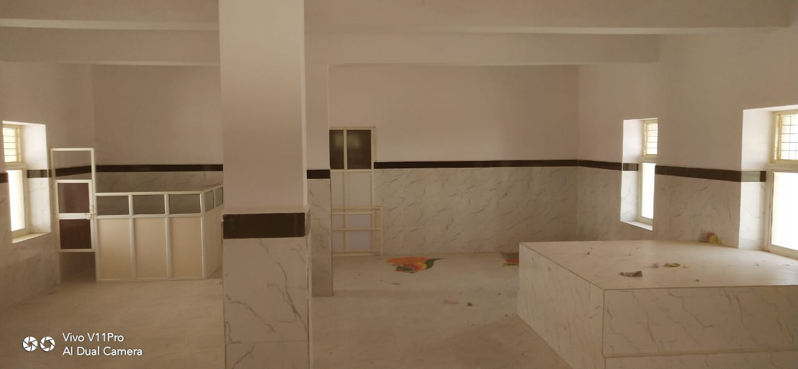
Unit 4
Will start shortly on 2nd floor of GMH, Rewa

